Slide 1
Cluster Analysis Metrics to Determine Patterns Across Networks (CAM)
Bartosz Bryg
Undergraduate Researcher – Institute for Data Science
New Jersey Institute of Technology, Newark, NJ
Collaborators:
Mohammad Dindoost
Oliver Alvarado Rodriguez
Dr. David A. Bader

Slide 2
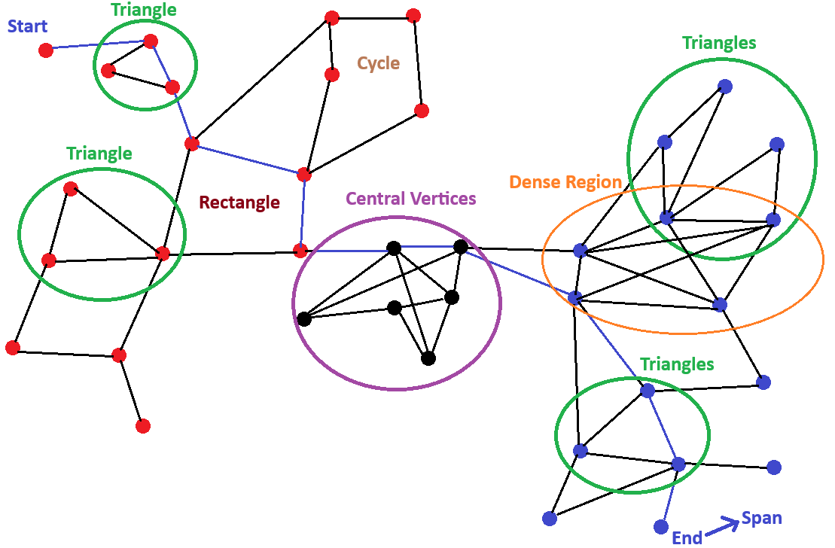
Why do metrics for graph clusters matter?
Detecting different patterns and trends in graphs
Determining the influence and properties of data
Analyzing the core-peripheral structure of the graph
Detecting communities for different networks

Slide 3
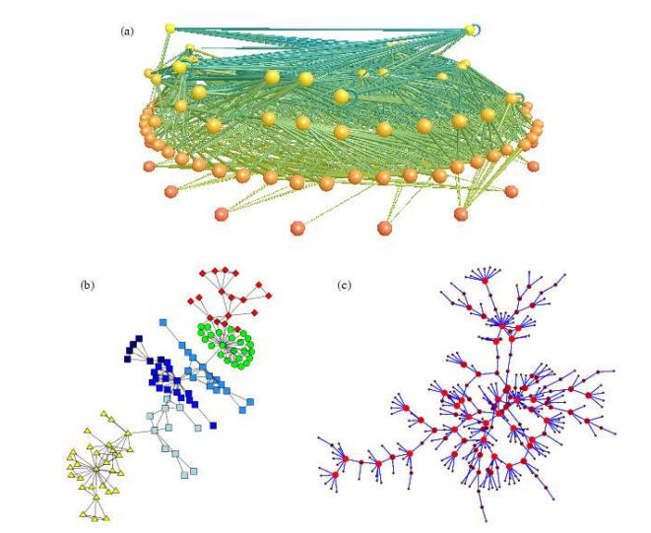
Motivation Behind Graph Metrics for Identifying Well-Connected Communities
Different types of networks require different metrics
Network structure varies across different domains (e.g., social vs. biological)
Use specific algorithms tailored to each network type
Algorithms should align with the network's connectivity and topology
Well-connected communities are more common in some networks than others
Metrics should adapt to the network’s density, purpose, and flow structure
“(a) A food web of predator-prey interactions between species in a freshwater lake. Picture courtesy of Neo Martinez and Richard Williams. (b) The network of collaborations between scientists at a private research institution. (c) A network of sexual contacts between individuals in the study by Potterat et al. “
(Image credit: [Newman 2003])

Slide 4
Types of metrics
Connectivity metrics
Density Metrics
Transitivity & Clustering Metrics
Eccentricity Metrics
Triangle Metrics
Distribution Statistics
Spectral Metrics
Core Metrics

Slide 5
List of metrics
Connectivity Metrics
Graph’s size
Number of edges
Minimum degree
Maximum degree
Average degree
Total Internal Edges
Second-order Average Degree
Degree Second Moment
Degree Variance
Degree Skewness
Edge connectivity lower bound
Vertex connectivity lower bound
Cluster volume
Cluster Cut-edges
Effective Diameter
Average Betweenness
Max Betweenness
Bridge Count
Bridges
Viecut Mincut
In Partition Size
Out Partition Size
Density Metrics
Density
Sparsity
Maximum Possible Edges
Core Density
Average Shell Density
Transitivity Metrics
Clustering Coefficient
Average Local Clustering Coefficient
Wedge Count
Triangle-to-Wedge Ratio
Global Transitivity
Cohesion Score
Eccentricity Metrics
Diameter
Radius
Number of Center Vertices
Center Vertices
Number of Peripheral Vertices
Peripheral Vertices
Average Eccentricity
Core Eccentricity
Distribution Statistics
Degree Distribution
Mean
Median
Standard Deviation
Skewness
Kurtosis
Key Percentiles (25th , 50th , 75th , 90th)
Triangle Distribution
Mean
Median
Standard Deviation
Skewness
Kurtosis
Key Percentiles
Degree Variance
Degree Skewness
Degree Second Moment
Assortativity
Path Distribution
Average Path Length
Effective Diameter
Reachability Ratio
Spectral Metrics
Conductance
Lambda lower bound
Lambda Upper Bound
Lambda Estimate
Triangle Metrics
Triangle Count
Triangle Density
Participation Rate
Max Local Triangles
Average Triangles Per Vertex
Triangle Centralities
Triangle Hitting Number
Core Metrics
Core structure
Core Number
Core Density
Max Core Size
Core-Periphery Structure
Core Periphery Score
Core Embeddedness
Core Strength
Periphery Size
Shell Decomposition
Shell Decomposition
Shell Densities
Shell Connectivity
Hierarchical Structure
Core Hierarchy Depth
Core Degree Correlation
Variance Hierarchy Balance
Core Stability
Core Stability
Core Persistence
Core Overlap
Core Quality
Core Modularity
Core Cohesion
Core Separation
Core Compactness
Core Connectivity Share
Core Interior Ratio
Core Expansion
22 5 6 8 25 4 7 23
Total
100 metrics in total! … and there is still much, much more!

Slide 6
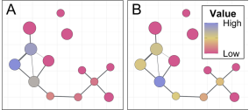
Connectivity Metrics
Measure how well the vertices are connected in a network
Identify isolated nodes or disconnected components
Detect susceptibility for edges/vertices failure (disconnection)
Present the general design and analysis of the graph
Algorithms and Theorems used:
BFS
Degree Counting through Neighborhood Count
Mader’s Theorem Bound
Newman’s Pearson Algorithm
Degree Aggregation
VieCut
Figure shows the connectivity for edges and vertices in the graph, ranging from high to low
(Image credit: [Petsas et al. 2021])

Slide 7
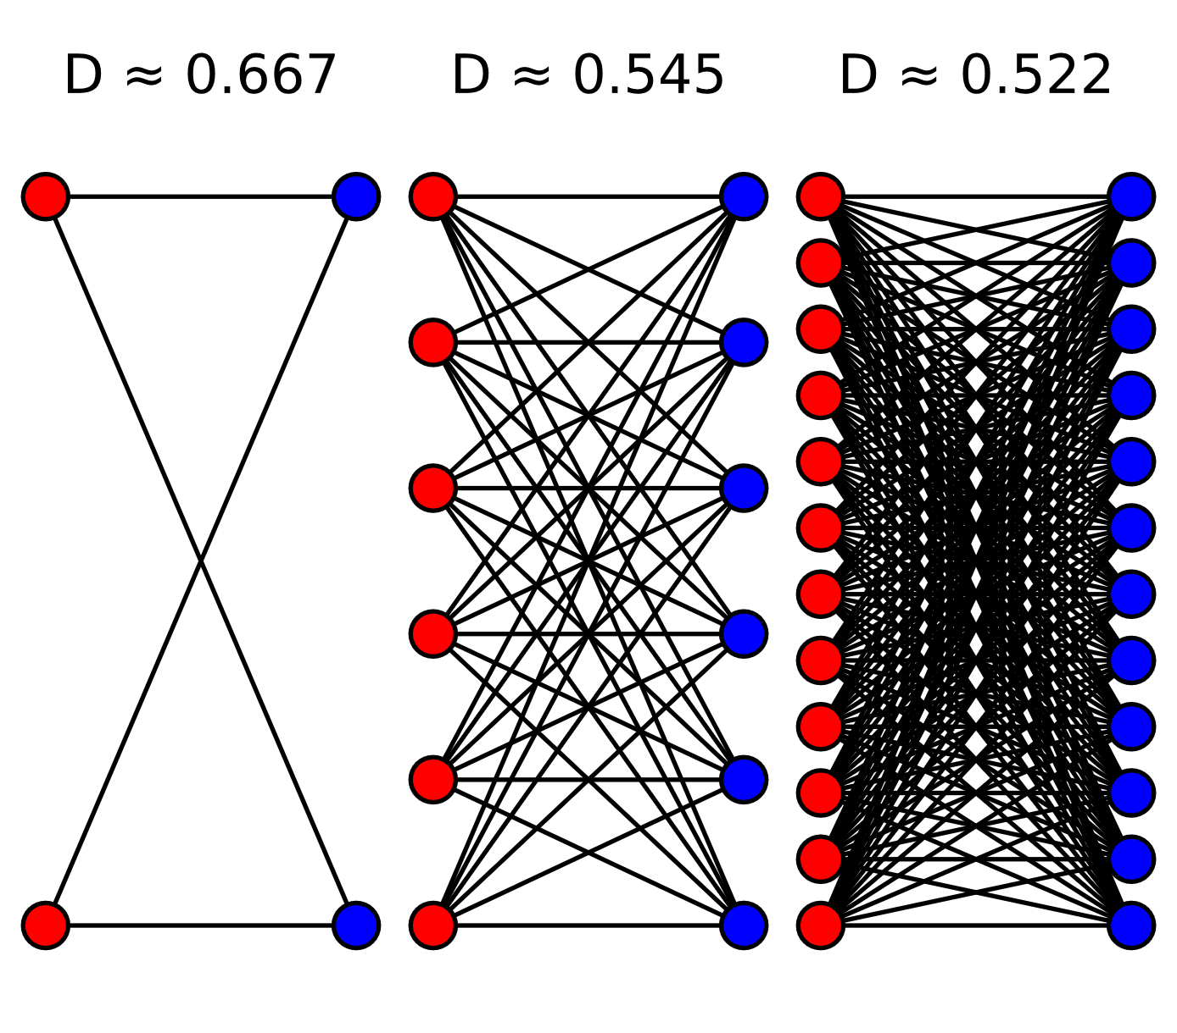
Density Metrics
Evaluate how densely the vertices and edges fill the graph
Indicate potential and likelihood for communication or interaction within the vertices and edges in the graph
Present graph complexity and clustering tendencies
Useful for detecting sparse vs. dense regions
Uses correlation and dependency of other metrics like the number of vertices and edges in the graph and the core
Figure presents graphs with increasing node counts and their corresponding densities D. Although the total number of edges increases, the density decreases because density is defined as the ratio of existing edges to the maximum possible number of edges. As the number of nodes grows, the maximum number of possible edges grows quadratically, causing the density to drop - even if the graph appears more connected visually.

Slide 8
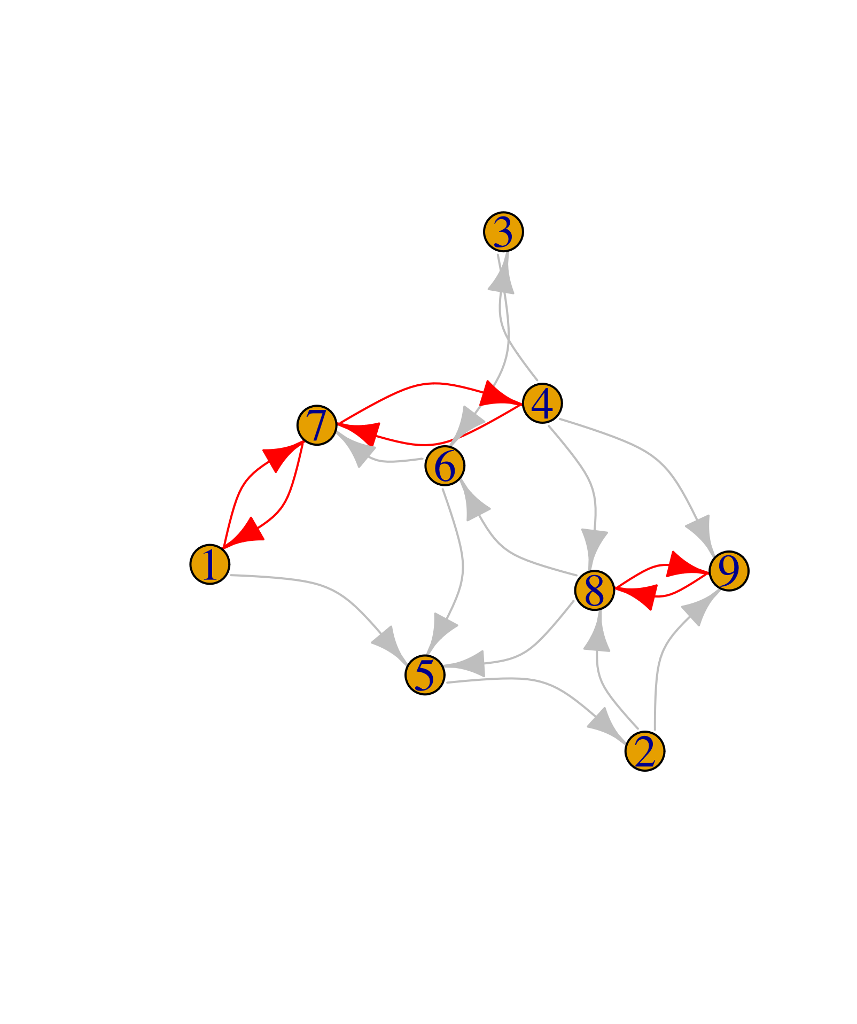
Transitivity Metrics
Algorithms and Theorems Used:
Wedge Counting
Vertex-Based Enumeration to detect shared neighbors
Global Transitivity
Global Clustering Coefficient (triangle to wedge ratio)
Watts-Strogatz model (Local Clustering Coefficient)
Measure the triangle and other shape-based connectivity and relationship
Indicate the tendency for vertices to form tightly-knit groups
Support community, subgraph detection
Help in detecting local clustering in the graph and the redundancy of vertices and edges in the graph, subgraphs, and communities
(Image credit: [Franceschet, M 2025])

Slide 9










Eccentricity Metrics
Capture distance from each vertex to its further vertex – the longest-shortest path of each vertex
Compute diameter, radius, and graph compactness (graph’s longest-shortest, shortest paths, and nearness between vertices)
Identify central and peripheral vertices
Useful in latency, reachability, and centrality of the graph analysis
Uses enhanced BFS to compute all longest-shortest paths from each vertex
Center Vertices

Slide 10
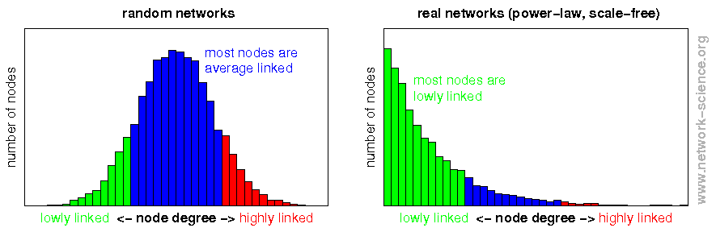
Distribution Statistics
Analyze the spread and shape of metric values
Compute statistics of the graph (e.g. mean, which is the total number of degrees over the graph’s size)
Reveal heterogeneity, diversity in degrees, triangle count, and path length
Support comparative analysis across network types
Include probability and statistics calculations such as mean, median, variance, skewness, and kurtosis
Algorithms and Theorems Used:
Quicksort algorithm to sort data
Newman’s Assortativity Coefficient
Probability and Statistics Theorems like mean, median, standard dev, etc.
Figures presents degree distribution of two different graphs. Left: random networks where most nodes are around average. Right: Real world networks with right-skewed distribution.
(Image credit: [Scholz 2024])

Slide 11
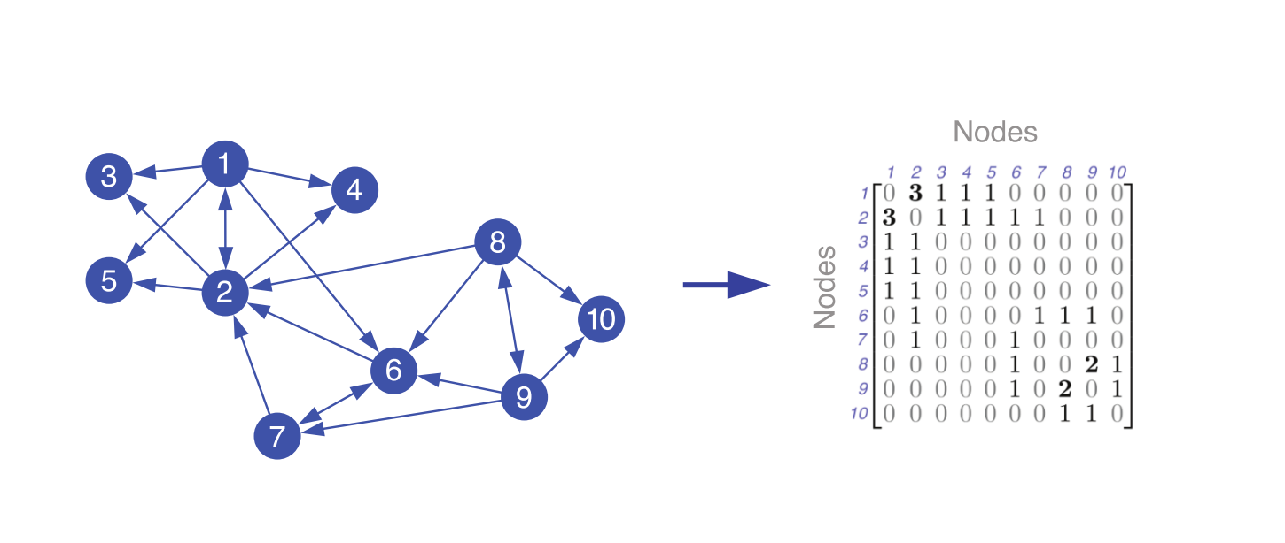
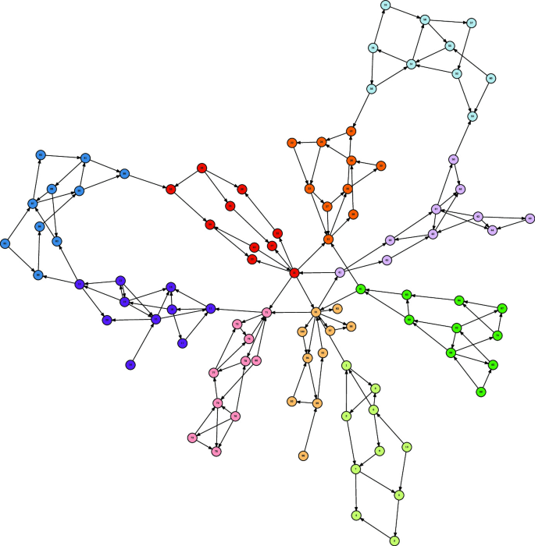

Spectral Metrics
Derived from the eigenvalues of the matrix representation of the graph
Measure connectivity, critical vertices, bridges, and graph partitions
Indicate graph cohesion and expansion properties
Used in clustering and community detection
Uses Cheeger’s Inequality Theorem: $\frac{λ_{2}}{2}≤φ\left(G\right)≤\sqrt{2λ_{2}}$
(Image credits: Top - [syllogismos 2025], Bottom – [Klus and Djurdjevac Conrad 2022])

Slide 12







Triangle Metrics
Algorithms and Theorems Used:
Hop count algorithm
Triangle Enumeration by Vertex
Triangle Hitting Set
Greedy removal of edges
0
3
Count triangle formations in the graph
Reveal local groupings and interaction clusters using triangle formation
Support triangle-based centrality/centralities and motif analysis
Identify cohesive subgraphs
0
3
4
2
1
2
0
3
1
2
4
2
Figure shows an example graph split into 3 triangles

Slide 13
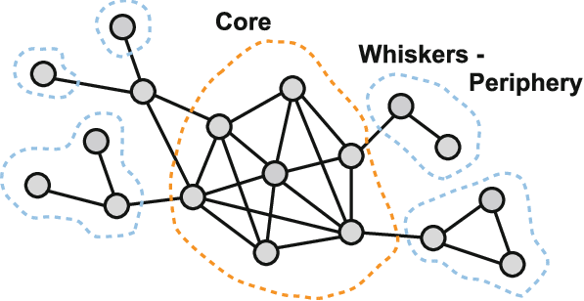
Core metrics – Dependence between core and the whole graph
Algorithms and Theorems Used:
K-core decomposition
Shell decomposition
VieCut
Modularity
Monte Carlo Trials (Core Stability through vertex removal)
Jaccard Similarity
Meaningful in almost all types of graphs
Derived from k-core decomposition
Extract a subgraph formed by high-connective vertices
Allow to pay attention to the most important vertices in graphs
Provides key points on the relation between core and periphery
Capture structural hierarchy and network resilience
Sample graph presenting the core - the most important part of the graph, and peripheral vertices as the graph’s whiskers
(Image credit: [Papadopoulos et al. 2011])

Slide 14
Selection of metrics for different networks
Network Type | Key Metrics Used
🚦Transportation Networks | Connectivity, Eccentricity, Core
📡Communication Networks | Connectivity, Spectral, Transitivity, Core
🧠Neural Networks | Density, Eccentricity, Triangle, Distribution Statistics, Core
📚Publication Networks | Transitivity, Spectral, Triangle, Core
👥 Social Networks | Connectivity, Transitivity, Triangle, Core
💻Computer Networks | Connectivity, Density, Transitivity, Core
💰Financial Networks | Eccentricity, Distribution Statistics, Triangle, Core
Specific metrics can fit specific networks
Different metrics for small vs large networks
Rejection method -> disregard metrics without meaning for specific networks
E.g. Connectivity metrics: communication, transportation networks, density metrics: social networks, transitivity metrics, biological networks, etc.
Figure presents the network association with specific metric categories

Slide 15


Metrics dependency
Diameter
Radius
Center Vertices
Peripheral Vertices
Eccentricities
Many network metrics are interdependent - calculating one can help infer or derive others
E.g, by calculating eccentricities we can derive metrics like diameter, radius, center & peripheral vertices
Algorithmic efficiency matters
Certain algorithms can compute multiple metrics simultaneously
Saves computation time
Reduces redundancy
Especially useful for large-scale networks
Degrees Calculation
Minimum Degree
Maximum Degree
Average Degree
Triangles
and
Wedges Count
Clustering Coefficient
Triangle to Wedge Ratio
Global Transitivity

Slide 16
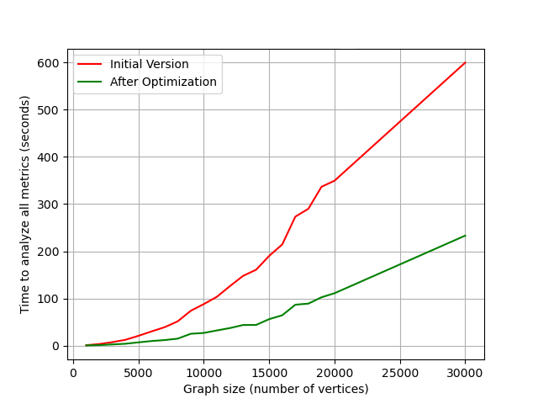
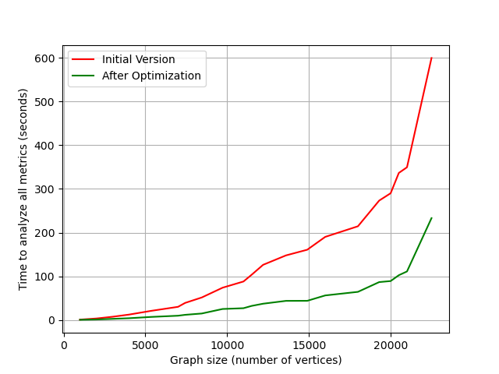
Metrics Calculation Performance
(a)
Significant opportunities exist to optimize performance in metrics computation
Certain metrics may be irrelevant for specific analyses and can be excluded
Techniques such as algorithm parallelization and sampling have proven effective in accelerating computation
(b)
(a) Time needed to calculate metrics concerning the number of vertices in the sample graphs
(b) Time needed to calculate metrics concerning the number of edges in the same sample graphs

Slide 17
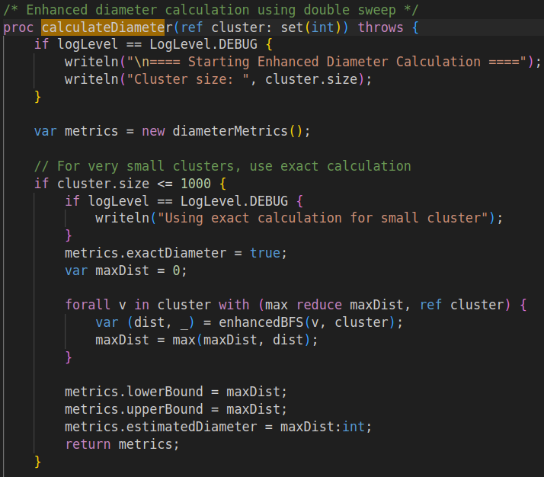
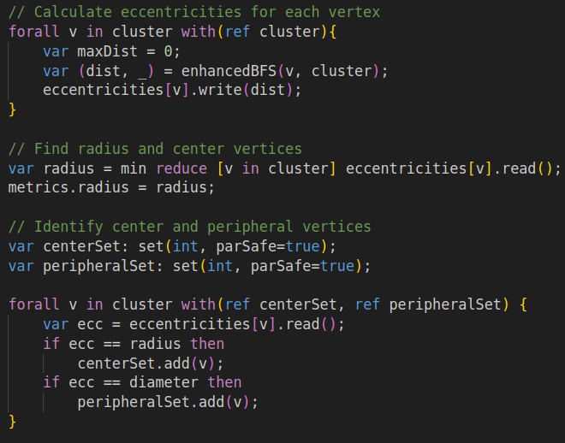
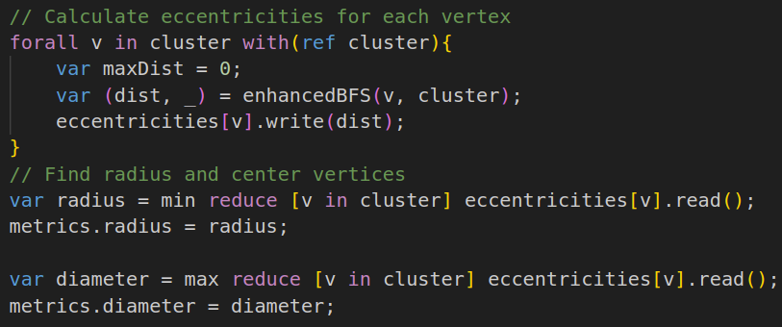

Method #1: Reducing function calls
Reducing Function Calls by Reusing Previously Calculated Metrics
Compute necessary metrics once within a function.
Store and reuse them across different operations to avoid redundant calculations.
Improves efficiency and speeds up execution.
Example: calculate the diameter using already calculated eccentricities without extra computations.

Slide 18

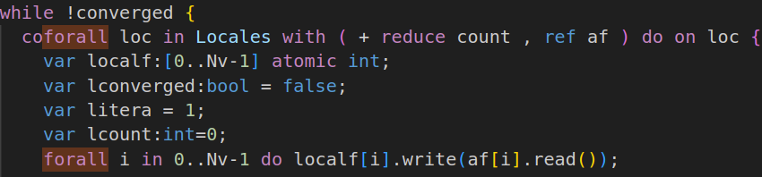

Method #2: Parallelization
Parallel Calculation Across All Vertices
Compute a specific metric by processing all vertices simultaneously.
Leverage parallel patterns to evaluate the entire graph at once.
Maximizes efficiency when metrics depend on all vertices.
Example: Using “forall” and “coforall” loops for Parallel Iteration, “reduce” to gather results from parallel tasks, and “atomic” for safe updates to shared data during execution

Slide 19
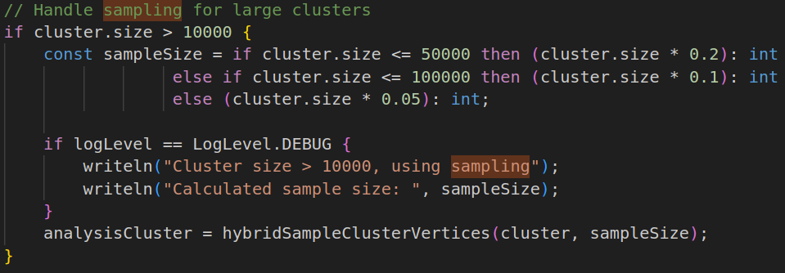
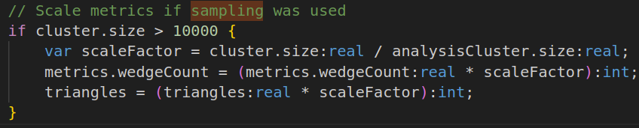
Method #3: Sampling
Sampling to Approximate Graph Metrics
Analyze a representative subset of vertices or edges instead of the entire graph.
Significantly reduces computation time while maintaining high accuracy.
Effective for very large graphs where full computation is too costly.
Example: Reducing graph size after reaching a specific threshold

Slide 20
References
Klus, Stefan, and Nataša Djurdjevac Conrad. “Koopman-Based Spectral Clustering of Directed and Time-Evolving Graphs.” Journal of Nonlinear Science, vol. 33, no. 1, 7 Nov. 2022, https://doi.org/10.1007/s00332-022-09863-0
Newman, M. E. J. “The Structure and Function of Complex Networks.” SIAM Review, vol. 45, no. 2, Jan. 2003, pp. 167–256, https://doi.org/10.1137/s003614450342480
Papadopoulos, Symeon, et al. “Community Detection in Social Media.” Data Mining and Knowledge Discovery, vol. 24, no. 3, 14 June 2011, pp. 515–554, https://doi.org/10.1007/s10618-011-0224-z
Petsas, Panagiotis, et al. “Landscape Connectivity Analysis: New Metrics That Account for Patch Quality, Neighbors’ Attributes and Robust Connections.” Landscape Ecology, vol. 36, no. 11, 13 Aug. 2021, pp. 3153–3168, https://doi.org/10.1007/s10980-021-01319-2
Scholz, Matthias. “Network Science: Node Degree Distribution.” Network-Science.org, 2024, www.network-science.org/powerlaw_scalefree_node_degree_distribution.html
Franceschet, M. (n.d.). Transitivity. Retrieved April 13, 2025, from https://users.dimi.uniud.it/~massimo.franceschet/teaching/datascience/network/transitivity.html
syllogismos. (2025). 5. Spectral Clustering. Weights & Biases. Retrieved April 13, 2025, from https://wandb.ai/syllogismos/machine-learning-with-graphs/reports/5-Spectral-Clustering—VmlldzozNzcwMDU

